Slide 1
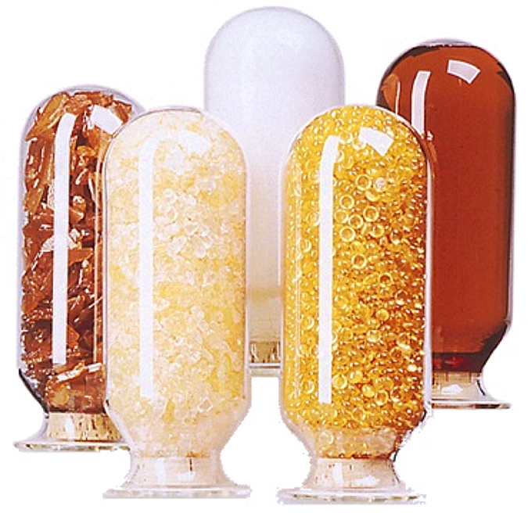
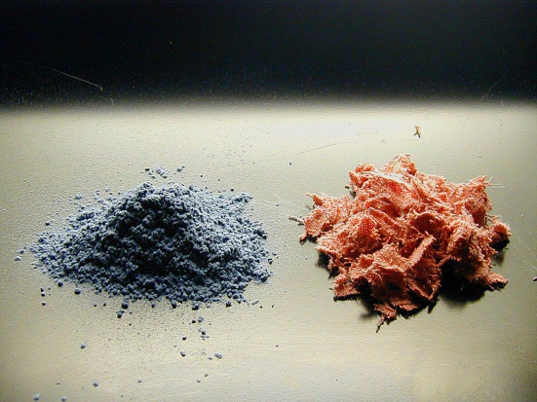
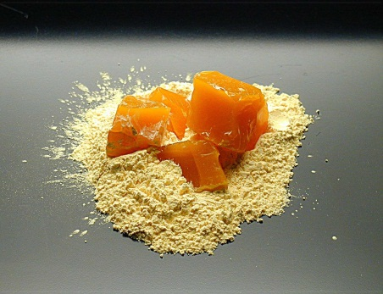
PHENOLIC RESINS
Dr.Widad Salih Hanoosh

Slide 2
Phenolic resins are the oldest commercially
manufactured synthetic polymer. They were first
'invented' by Leo Hendrik Baekland in 1907. He
was the one to develop an economical method towas the one to develop an economical method to
convert these resins to moldable formulations which
were transformed by heat and pressure to hard and resistant molded parts.
Introduction

Slide 3
-Phenolic resins are distinguished by broad array of
application areas amongst Thermosetting and
Thermoplastic resins.
-They are relatively inexpensive and highly versatile
having vital role in construction, automotive, electrical,
and appliance industries.
-They are irreplaceable materials for selective high
technology applications offering high reliability under severe circumstances.
Why Phenolic Resins

Slide 4
- Excellent thermal behavior
-High Strength level
-Long thermal and mechanical stability.
-Excellent fire, smoke,and low toxicity
characteristics.
-Excellent electrical and thermal insulating
capabilities.
-Excellent cost performance characteristics.
Cont.

Slide 5
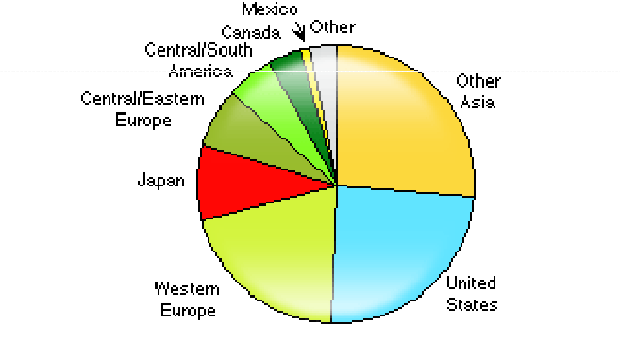
World Consumption of Phenolic Resin -2015

Slide 6
Phenolic resins are obtained by step growth polymerization of
difunctional monomers (aldehydes) with monomers of functionality greater than 2 (Viz, Phenol, substituted Phenols or combination of phenols).
Key factors in the design of the desired phenolic resin are:
- Molar ratio of F to P
- Mode of catalysis: Acid, base, metal salt, enzyme.
- Mode of catalysis: Acid, base, metal salt, enzyme.
-Liquid, Solid, dispersion
-Thermoplastics or thermosetting
Low to medium Mw are considered as “ Reactive intermediates which
can be cured or undergo various transformation reactions via reactive
hydroxyl group viz, Epoxy,allyl, cyanate or form new ring structure.
Basic Chemistry

Slide 7
Note: Reaction of phenolic compounds with aldehydes under acidic or basic catalyst are exothermic , so side reaction due to exothermic need to be avoided
- Phenol, o,m,p-Cresol, p-tert Butylphenol, p-tert Octylphenol,
p-Tert Nonylphenol, (2,3), (2,4), (2,5), (2,6), (3,4), (3,5) –
Xylenol, Resorcinol, Bisphenol A, Bisphenol-F.
Formaldehyde, Acetaldehyde, Propionaldehyde, butyraldehyde ,Glyoxal , Furfural , nbutyraldehyde ….etc.
Raw Material and Catalyst

Slide 8
Catalyst:
-Acid: Organic Acids and Mineral acids
-Base: NaOH, KOH
- Metal Salts.

Slide 9
Note : Varying the mole ratio of phenol to formaldehyde ( F: P ) , type of catalyst , decided:
Molecular weight
Functional Group avilable
Melting range of the products

Slide 10
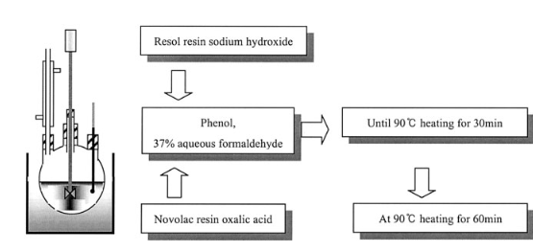
Three reaction sequences must be considered:
1. Formaldehyde addition to phenol.
2. Chain growth or prepolymer formation.
3. Cross linking or curing reaction.

Slide 11
Phenolic resin process
Phenol
Excess Formaline
Basic Medium
Excess Phenol
Formaline
Acidic Medium
Resol
One stage prepolymer
Novolac
Two stage prepolymer
Heat Cure
Curing Agent
Net Work Structure

Slide 12
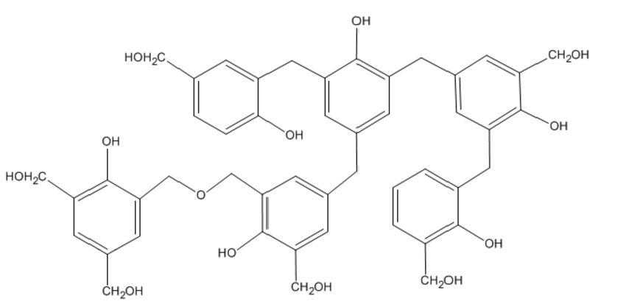
Methylol Group
Methylene Bridge
Ether Bridge
Aromatic Hydroxyl Group

Slide 13
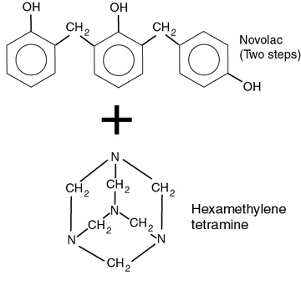
Curing agent

Slide 14
Two prepolymers types are obtained depending on pH
Type of Phenolic Resin | Novolac Resin | Resol Resin
Type of Reaction | Electrophelic Mechanism | Nucleophilic Mechanism
Medium of Reaction ( pH) | Acidic Med. ( 1-5 ) | Basic Med. ( > 7)
Molar Ratio ( P:F ) | 1: 0.8 | 1:2- 1:4
Type or behavior of Polymer | Linear or Slightly Branch | Branch
Characteristic Properties | Low MWT, Soluble | Low MWT , non Soluble

Slide 15
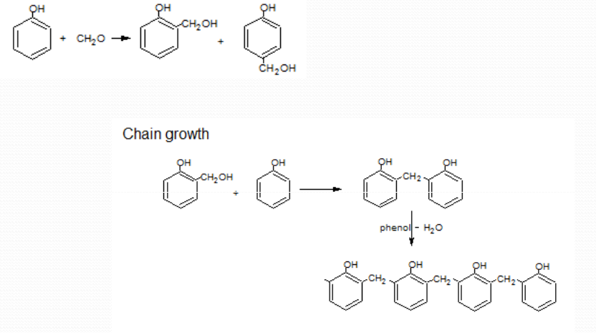
In acidic medium
In acidic medium convert CH20H to ……………
Chain Growth
Novolac

Slide 16
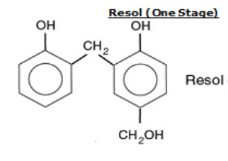
Basic Medium
Methylol group

Slide 17
Effect of catalyst type on the position of sub. In the case of Novolac
- 4-6 pH With Divalent metal salts as
catalyst: High Ortho (57-58%: o-o, 40-42%: o-p and 2-3% p-p)
- Oxalic Acid: (25-26%: o-o, 48-50%: op and 25-30 % p-p
- Phosphoric Acid: (23-25%: o-o, 50-52%: o-p and 25-30 % p-p )
Sulphuric Acid : (25-26%: o-o, 4550%: o-p and 25- 30 % p-p)
Note : also the softining point of the product will be chang ( 80 – 100 Cent. )

Slide 18
Curing Chemistry of Resol and Novolac
Novolac
Novolac because it dose not contain reactive groups in their structure , so the curing chemistry must be needed to curing agents like formaline and hexamethylene tetra amine ( hexamine ) .Heating is very important factor for complete the curing.
???????
????
Net Work Structures.

Slide 19
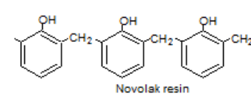
Hexamine – Heating ( 135-150 C)
Final Products?????????

Slide 20
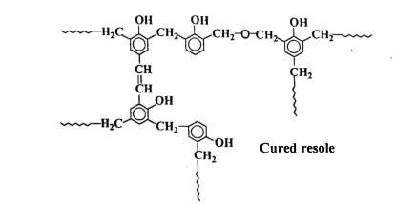
Curing of Resol Resin
The resoles at the time of synthesis are in the – A- stage , being easily meited and soluble in anumber of solvents.They are one- step resins and if heated, passes first into the – B – stage ( resitol ) , where the resin is partially crosslinked and swollen by solvents. On farther heating they converted into completely crosslinked – C – stage ( resite ) , which is insoluble and infusable polymers.

Slide 21
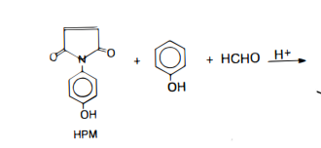
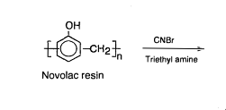
Q1- Write the chemical structure for the polymer prepared from the following reactions
1-
2-

Slide 22
3-
Cured phenolic resin ( resol ) with PVA
Cured epoxy novolac with ethylene diamine
4-
Novolac from phenol and furfural
5-
Phenol, formaline , 8-hydroxy quinoline ( ter-polymers )
6-

Slide 23
Toughness of phenolic resin
Improvement in toughness of phenolic resin was done by blending with rubbers like carboxylated nitrile rubber , vulcanised silicone , epoxy functional butadine rubber …..etc.
Improvement in thermo oxidative of phenolic resin
To improve the thermo-oxidative stability ,chemical modification have been tried such as etherfication and esterfication of phenolic hydroxyl group . Complex formation with polyvalent elements such as boric acid , phosphoric acid , amine compounds and silicon compounds

Slide 24
Q- Write the steps for thermal degradation of pheonlic resin
PYROLYSIS OF PHENOL-FORMALDEHYDE RESIN: EXPERIMENTS AND MODELING
Michael A. Serio, Sylvie Charpenay, Rosemary Bassilakis, and Peter R. Solomon
Advanced Fuel Research, Inc.
87 Church Street
East Hartford, CT 06108

